Slide 1
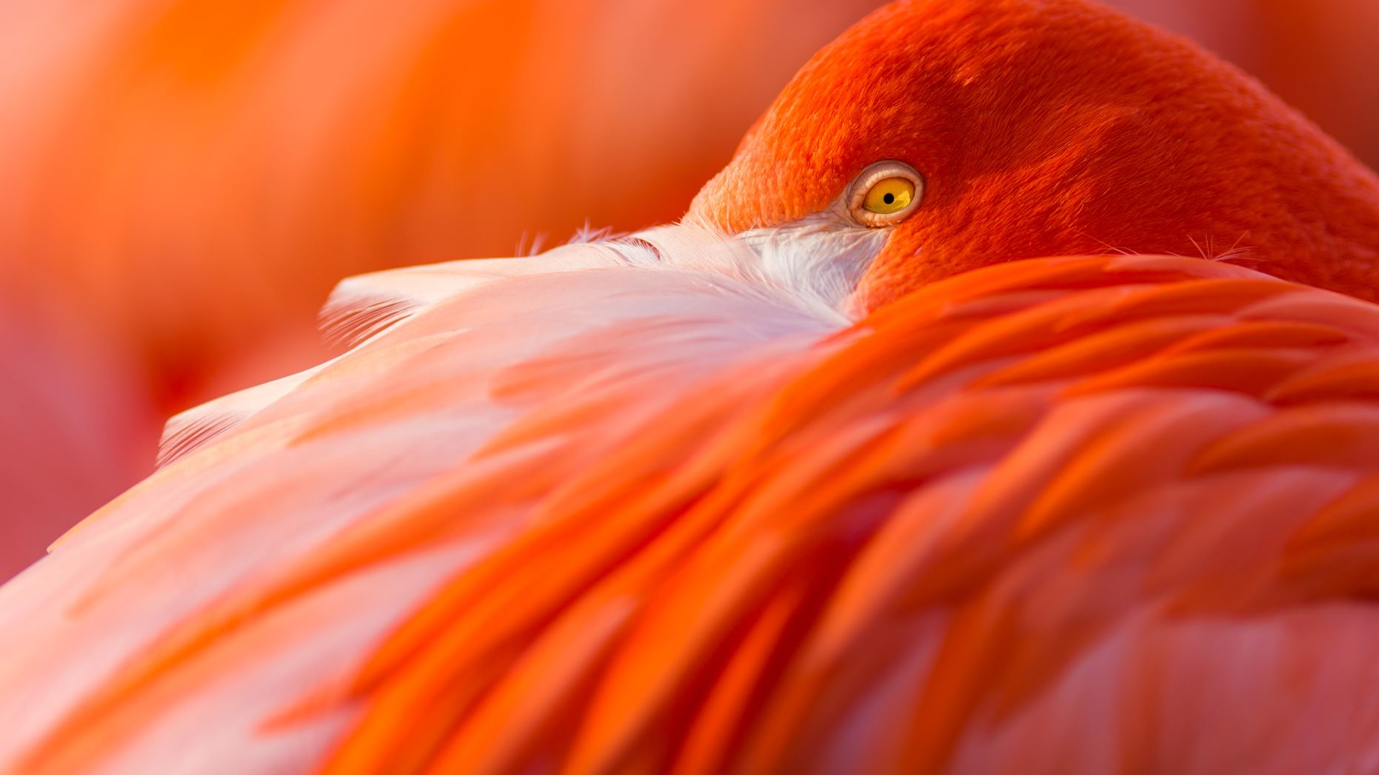

IUCN Red List Most Endangered Species
Taylor Woodington
Notes:
Hello all! Today we are going to be discussing the IUCN Red List Most Endangered Species and possibilities of moving forward to protect them.

Slide 2
The Problem
Increase of number of species on the IUCN endangered species list
​ Limited habitat management and conservation focus
Notes:
A problem when looking into the IUCN Redlist, also known as The International Union for Conservation Care, is that it is constantly changing, species are getting added, removed, or moved around on the list depending on population numbers which have the potential to change daily. In Addition there is limited habitat management and conservation focus on certain species if people do not possess the knowledge that there are specific species in need or danger. This project aims to recognize those species and move forward with ways that we can protect them in the future.

Slide 3
Background
Least Concern
Near Threatened
Extinct
Vulnerable
Endangered
Critically Endangered
Extinct in the Wild
Notes:
When looking at how the IUCN classifies species of animals we find that there are seven categories that can be put into. Going from those of the most minimal concern to those of the most with most severity of loss in their population we start with Least Concern, move to Near threatened, vulnerable, then endangered, to those critically endangered, and then extinct in the wild which means they could exist in human care somewhere, and then we have extinct which means that the population is damaged beyond repair. What will determine a species listed status is a combination of their population size, rate of decline, geographic distribution and the degree of populati on and distribution fragmentation. For example, a population with a slightly lower size but steady increase may be ranked of lower concern than a population with a bit of a larger size and a high rate of decrease in their population.

Slide 4
Preparation and Methods
Remove missing values
Drop Data Deficiency column
Highest Count of Tax Groups for Each Status
Proportion of Threatened Species
Create Tree Map
Classification Model
Confusion matrix
Notes:
In order to prepare this data for use, I removed unnecessary or missing values as well as the data deficiency column which posed no asset to the data evaluation. From there I made visuals to understand what the highest count of taxonomic groups were for each conservation status to see which conservation status was the most concentrated in species. Afterwards I decided to proportion out the threatened species across groups to get an understanding of which groups were at the most risk and then created a tree map to show these proportions. Following this I created a model by testing and training the data with a confusion matrix to see if there was understanding of how to classify species at risk and not within a list.

Slide 5
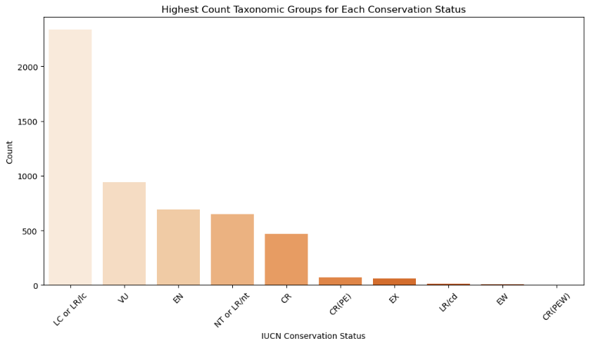
Notes:
When looking at the highest count of taxonomic groups for each conservation status we see that least concern has the most with around 2,330 species in their category whereas the others have less. However if we were to take critically endangered, endangered and vulnerable and added them all together we would get about 2,100 showing that those species are important and a lot are at risk. Just at risk in different stages.

Slide 6
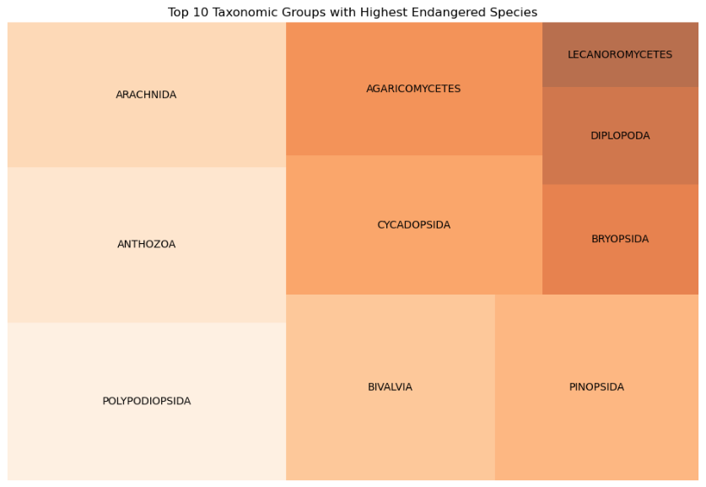
Notes:
Moving forward we see in our tree map that Polypodiopsida also known as ferns and Anthozoa also known as corals are both those with the highest amount of species of concern. It is important to have these species taken care of. Those of these classes are species which assist greatly with the environment taking carbon dioxide out of the air or water and producing oxygen for other species to thrive off of.

Slide 7
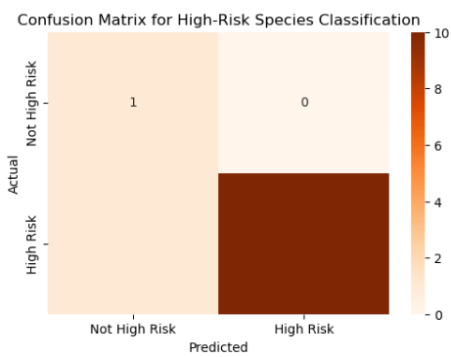
Notes:
Following the previous slide of those species being at high risk. I wanted to create a model that would classify if a species was at high risk or not. Here is the confusion matrix for that model. We have a 92% rate with the model showing a high confidence that it can properly classify species of concern. Local wildlife districts could use this to see what their focus species should be on in their area.

Slide 8
Conclusions and Assumptions
>500 species
High Risk Groups:
Anthozoa
Classification Model
Trustworthy results
Polypodiopsida
Endangered
92% Accuracy
Vulnerable
Notes:
Overall, we understand that over 500 species are vulnerable or endangered. The groups of the highest risks are polypodiopsida and anthozoa which are our oxygen creators in habitats. And finally, the classification model could be used in the future positively to give local districts trustworthy results and understanding of what species to focus on the most.

Slide 9
Future Recommendations and Implementation
Water, Soil, and Air quality
Break Down Taxonomic Grouping
Focus on Genus Species
Identify high risk species
Habitat management
Notes:
Moving forward, if there was a breakdown in the taxonomic grouping we could have focus genuses or species which we can see what specific species need the most attention and assistance in their habitat. From there, more habitat management practices can be introduced. For example, planting or introduction of organisms which would create positive symbiotic relationships or checking and changing habitat factors such as plants in the area to adjust water, soil, and air quality for overall habitat health indication. Moving forward this model can propose direction and action in helping out the species in need.

Slide 10
References
Harshith, J. (2021, November 29). Number of species in each IUCN Red List Category. Kaggle. https://www.kaggle.com/datasets/johnharshith/number-of-species-in-each-iucn-red-list-category?resource=download
The IUCN Red List of Threatened Species. IUCN Red List of Threatened Species. (n.d.). https://www.iucnredlist.org/

